Slide 1
Sharding Strategies of MongoDB
By Jiarong Ye (jxy225)

Slide 2
Sharding is a method for distributing data across multiple machines to:
Scale the system horizontally (i.e. add more servers to divide the overall workload, hence increase capacity)
Support deployment of applications with
large data sets
high throughput operations

Slide 3
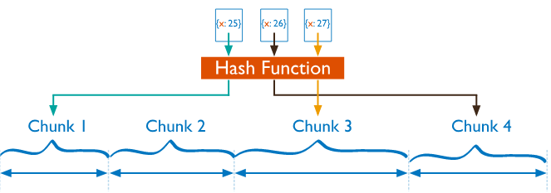
Sharding Methods of MongoDB
Hashed Sharding
Compute the hash value of the shard keys using carefully designed hash functions
Assign a range to each chunk based on the hash value
(Source: Retrieved from https://docs.mongodb.com/manual/sharding)

Slide 4
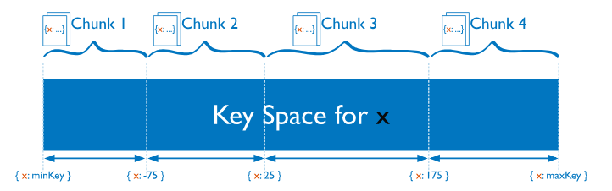
2. Ranged Sharding
Divide data into ranges based on the shard keys, and the more similar shard keys are more likely to be assigned to the same chunk
Efficiency heavily depends on the shard keys chosen. Wrong choices might result in uneven distribution of data, therefore causing performance bottlenecks
(Source: Retrieved from https://docs.mongodb.com/manual/sharding)

Slide 5
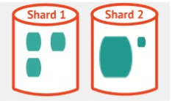




Choose a proper shard key:
01
Cardinality
VS
02
Even Distribution
VS
Low overhead for merging by querying just one or two shards at a time per query instead of all the shards
03
Query Isolation
Shard key = Hash(DeviceID) + Hash(TimeStamp)
(Random)
(Sequential)

